Slide 1
The Modern Bee Hive
The Langstroth Hive

Slide 2
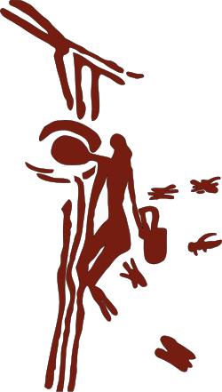
A History of Bees and Man
The “Honey Seeker” – cave painting near Valencia, Spain is the earliest record that we have on beekeeping dating back 8
thousand years.

Slide 3
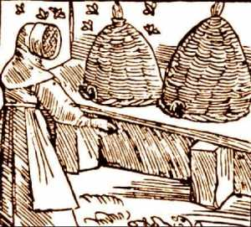
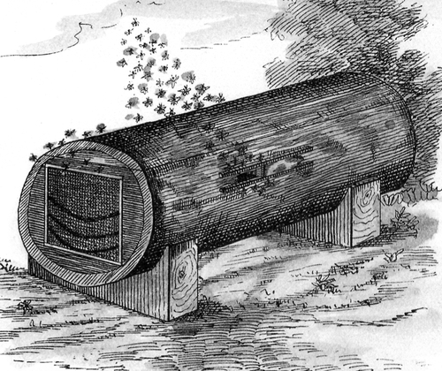
Bees and Man go way back
At some point in time man decided to keep wild bees in artificial hives. These first hives were most likely hollow logs, pottery vessels, wooden boxes or straw baskets or “skeps”.

Slide 4
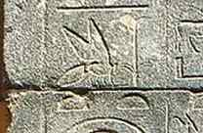
Bees and Man go way back
3000 B.C. – Written records indicate that migratory beekeeping up and down the Nile River in Ancient Egypt was a common practice.
The Egyptians had a steady supply of honey from domesticated bees, but wild honey was especially valuable. Honey hunters were protected by royal archers as
they search the wild wadis
for bee colonies.

Slide 5
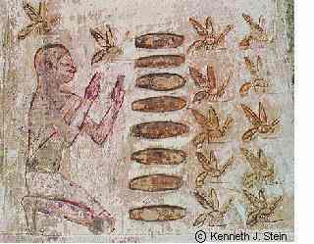
Bees and Man go way back
The tomb of Pabusa (625 B.C.)

Slide 6
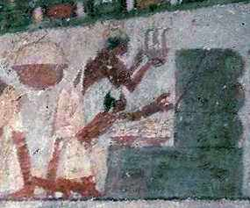
Good for Man bad for bees…
Unfortunately these types of hives were not very good when it came to harvesting the honey. The colony would many times be destroyed in the process of removing combs of honey.

Slide 7
Many times bees would find a home in a structure built by man, much like they still do today…

Slide 8
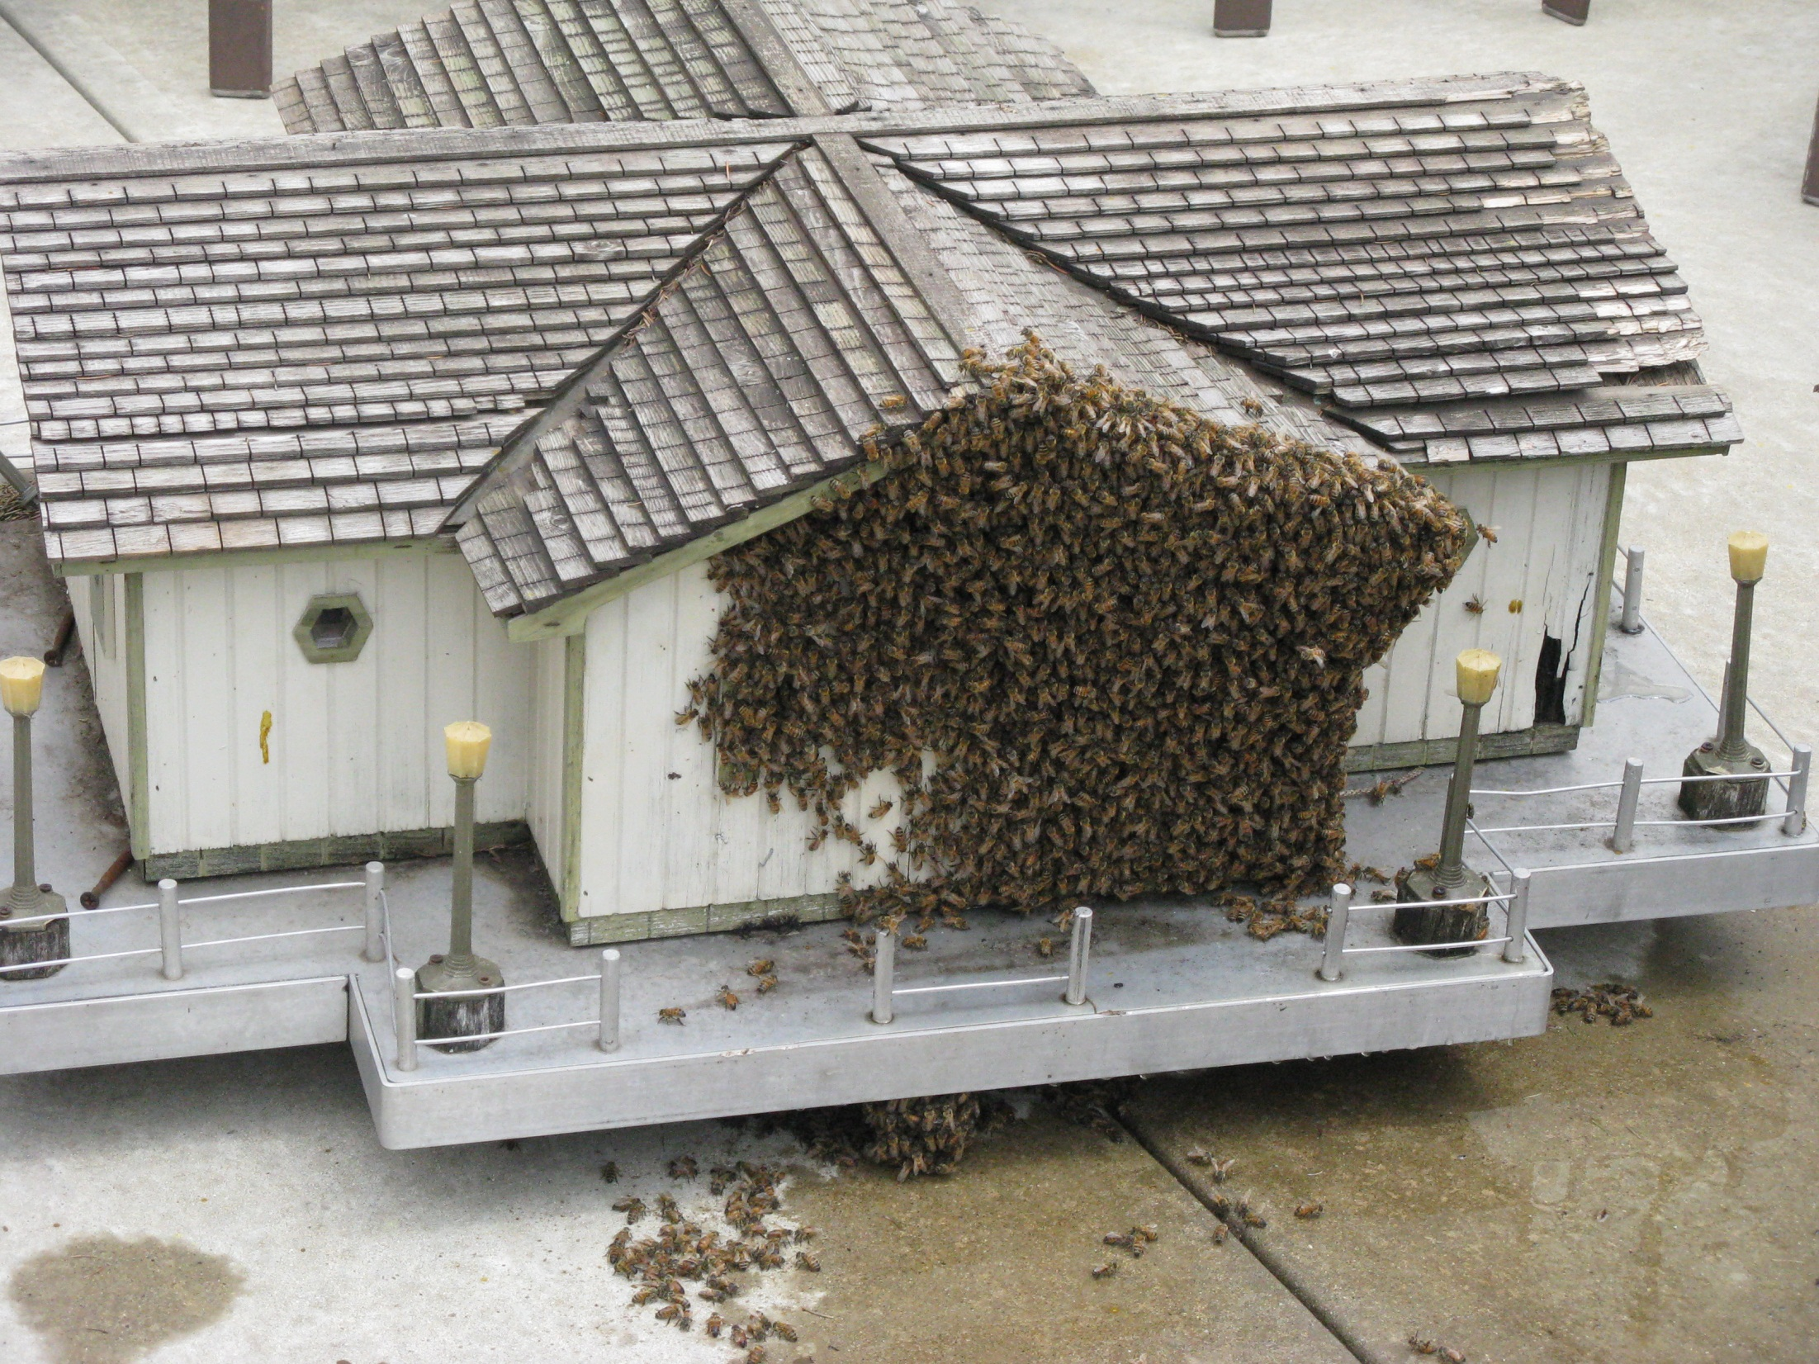

Slide 9
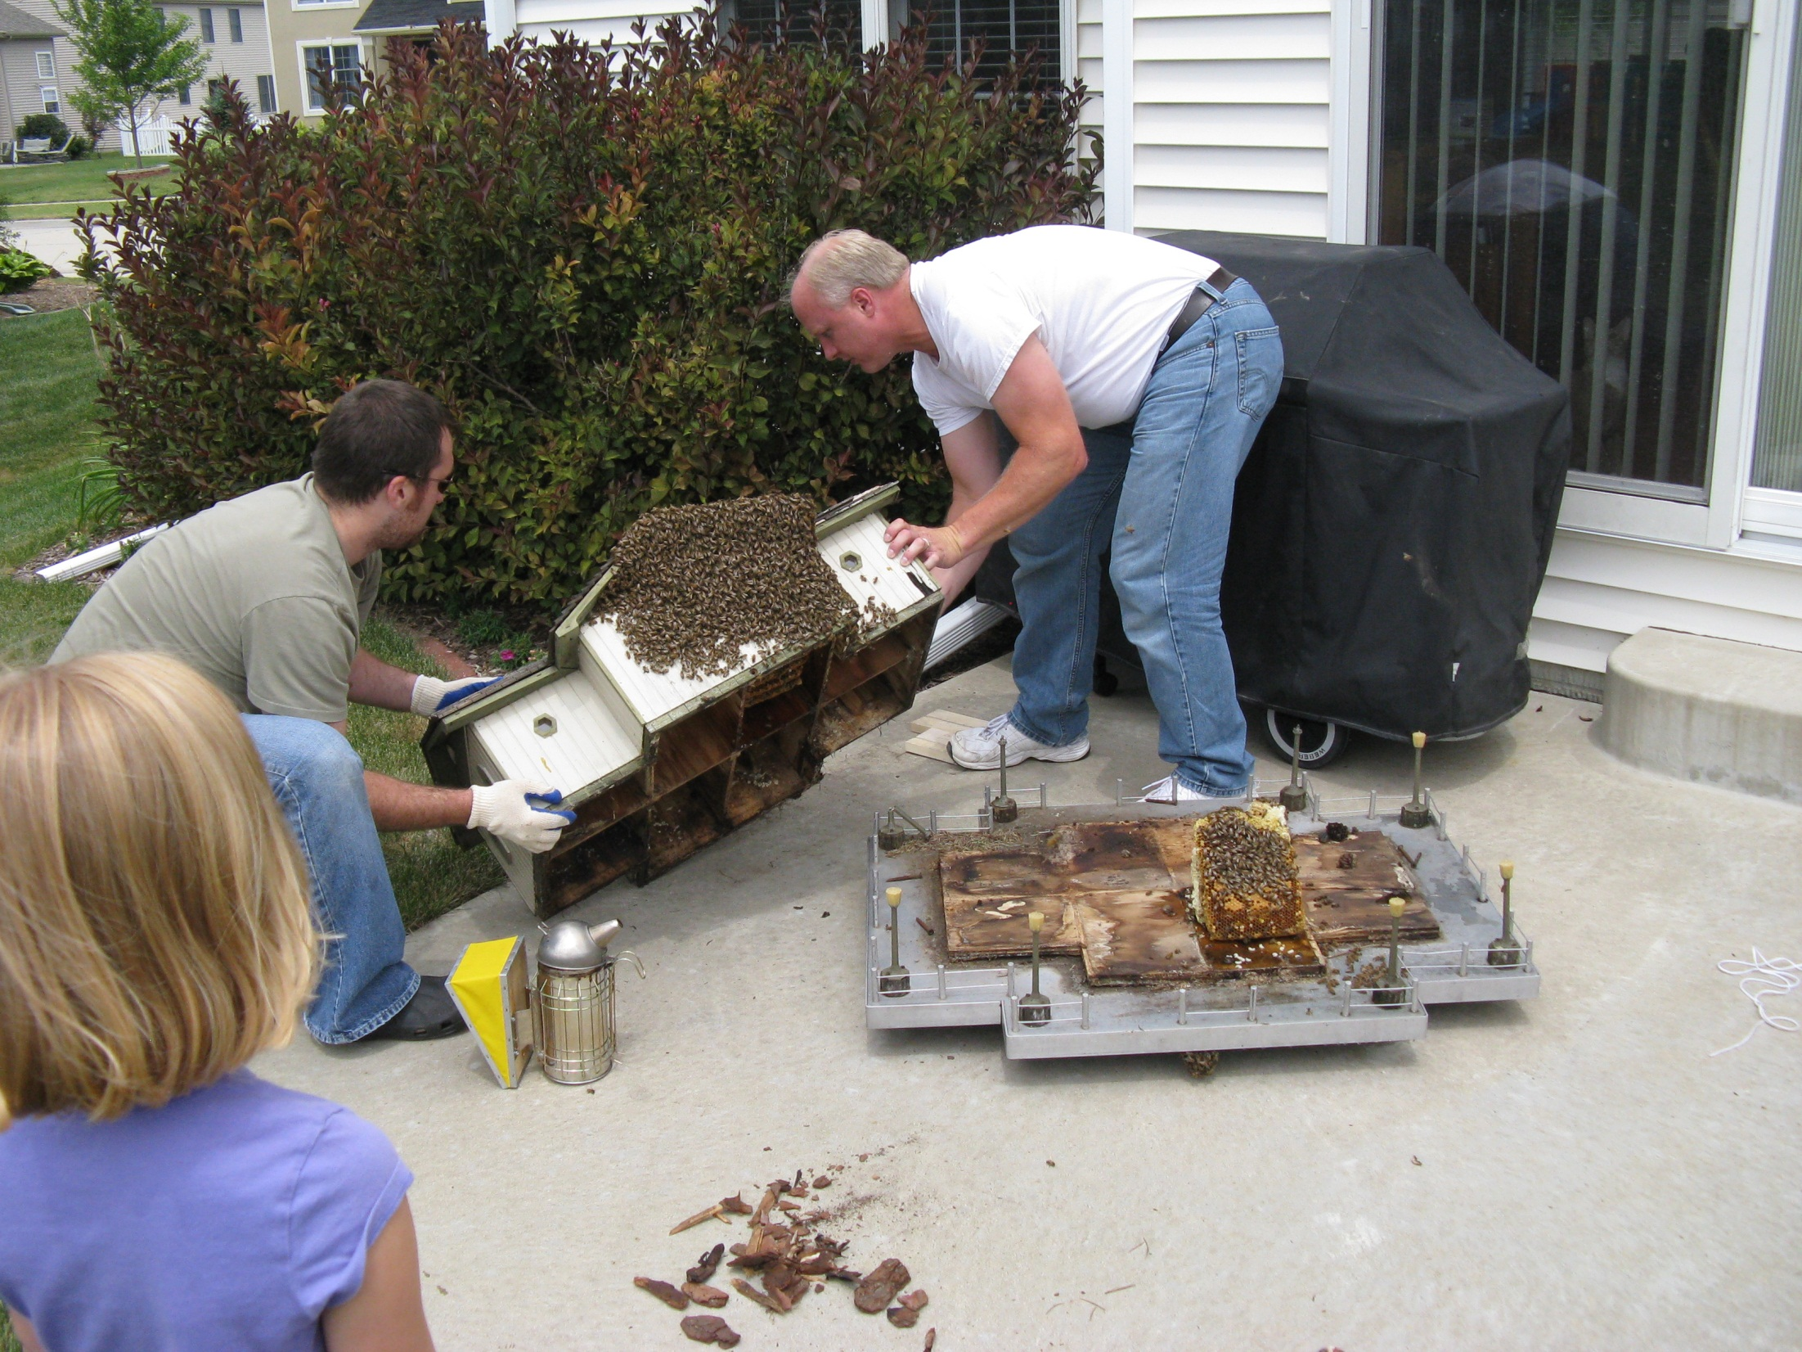

Slide 10
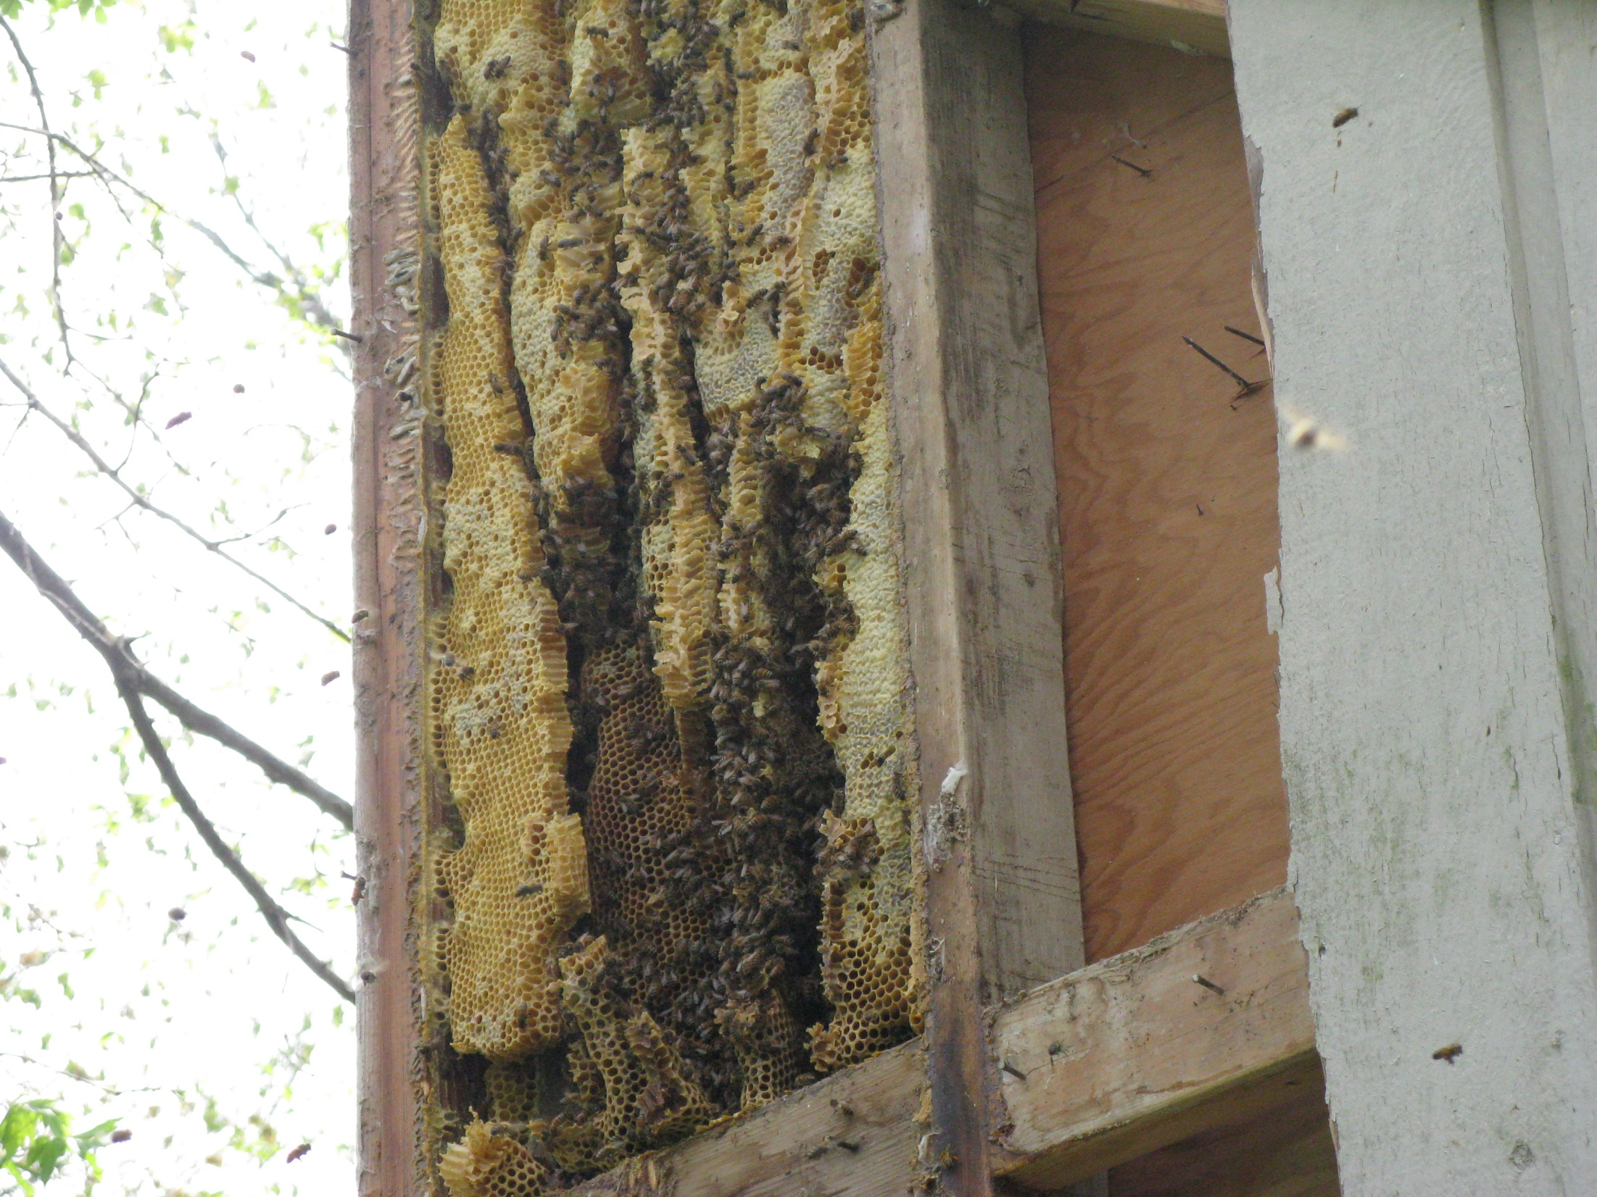

Slide 11
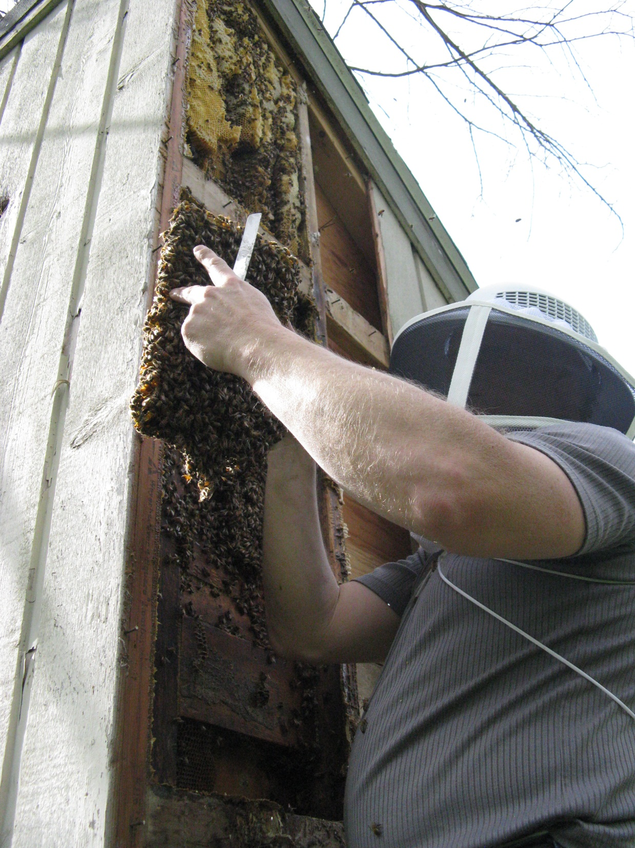

Slide 12
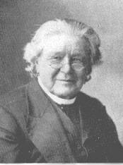
Fast forward to 1851 and the discovery of the “Bee space”
Rev. Lorenzo Lorraine Langstroth
(25 December 1810 – October 6, 1895), apiarist, clergyman and teacher, is considered the "Father of American Beekeeping."

Slide 13
Bee Space
The bee space is ~ 3/8 inch – any space smaller the bees will glue it together with propolis. Any space larger than 3/8 the bees will build comb to bridge the gap.

Slide 14
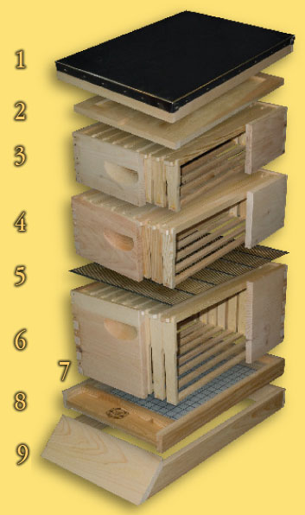
Components of a Bee Hive:
A typical hive arrangement would include a hive stand, bottom board, 1-2 hive bodies or 2-3 medium supers for the brood chamber, 1-3 honey supers, inner cover, and all topped with an outer cover. Can be 8 or 10 frame.
Telescoping Top: Covered with Heavy Aluminum
Inner Cover: Provides insulation for heat and cold
Shallow (5-11/16") Super: Widely used as comb honey super
Medium (6-5/8") Super: Great honey storage and extracting super
Queen Excluder: Prevents queen from laying eggs in honey super
Hive Body: Used as the brood chamber for new eggs and rearing bees
Entrance Reducer: Cuts down the size of the entrance
Bottom Board: Provides ventilation and aids in mite fall
Hive Stand: Raises bottom board off ground and provides a landing board

